Slide 1
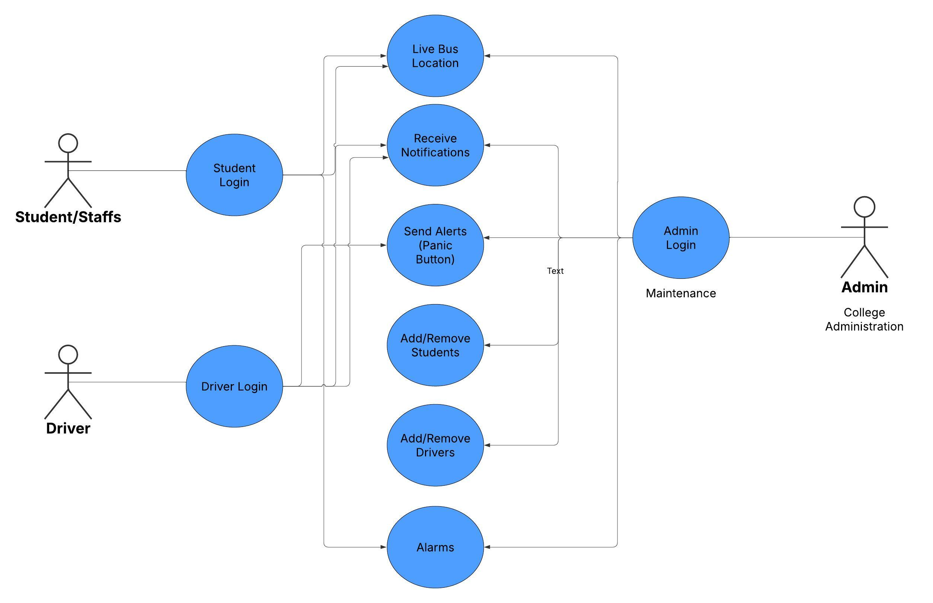
USECASE DIAGRAM

Slide 2
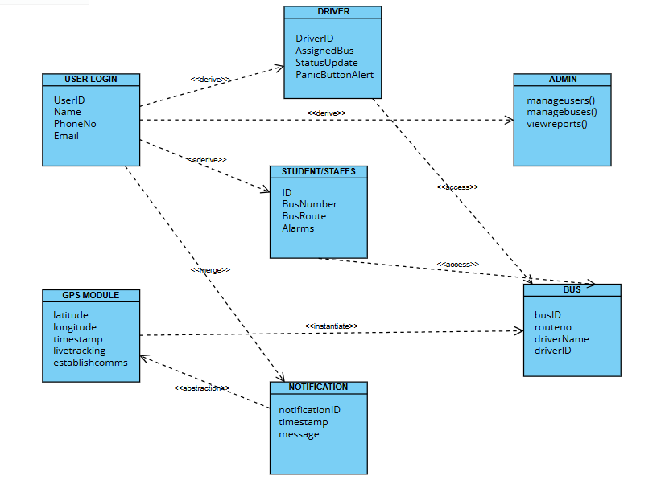
CLASS DIAGRAM

Slide 3
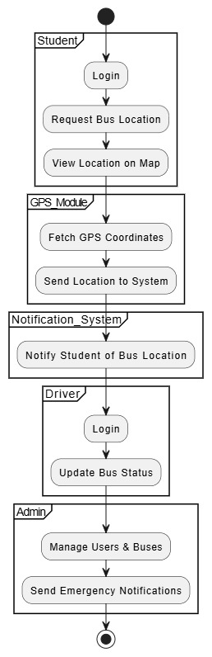
ACTIVITY DIAGRAM

Slide 4
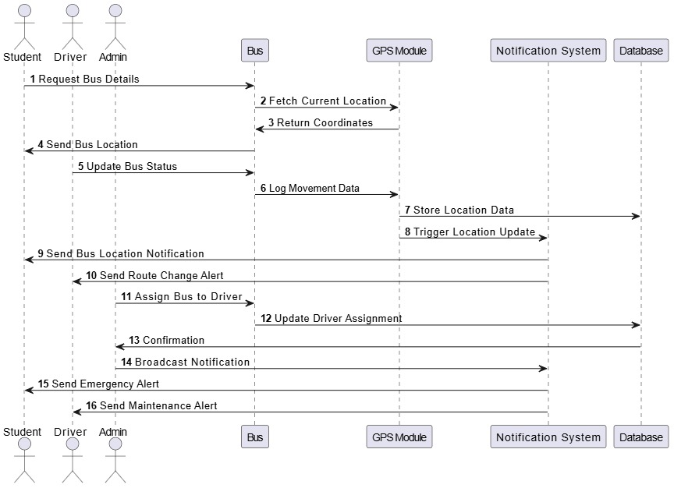
SEQUENCE DIAGRAM

